Slide 1
LCD 四子棋
HARDWARE LAB. FINAL PROJECT DEMO
數學系 101021120 鄭宇翔
數學系 101021110 林力暐

Slide 2
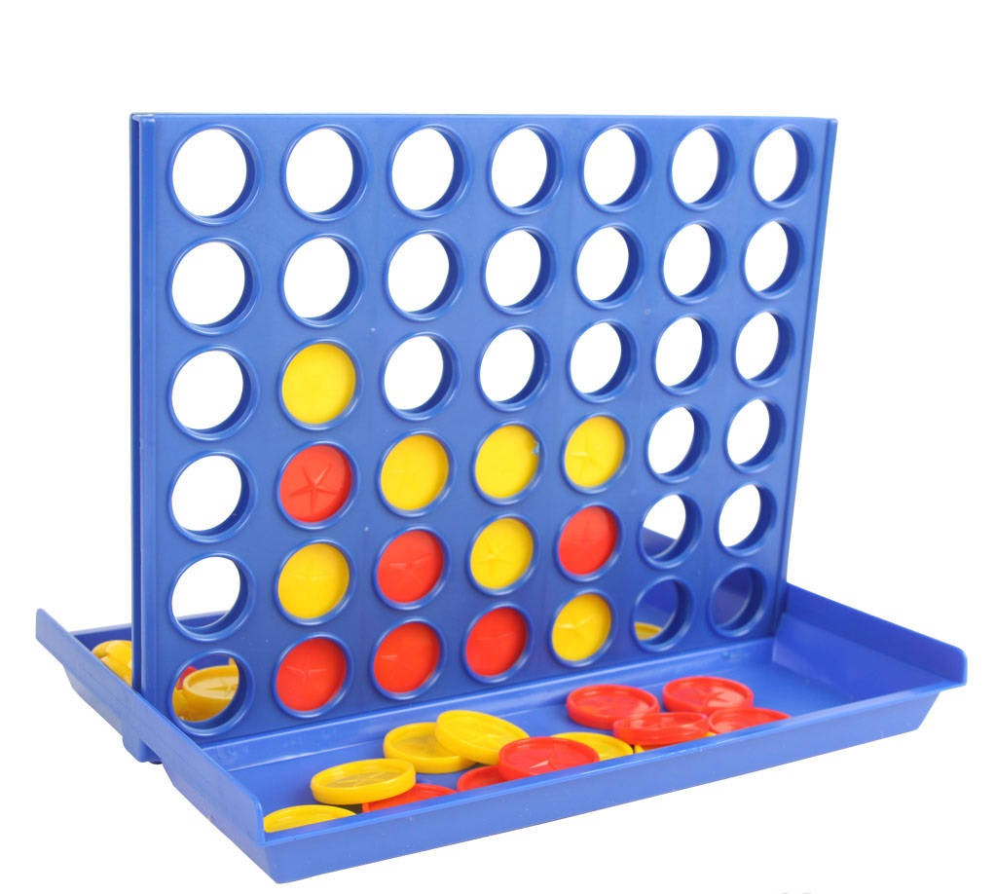
What is 四子棋 (Connect Four) ?

Slide 3
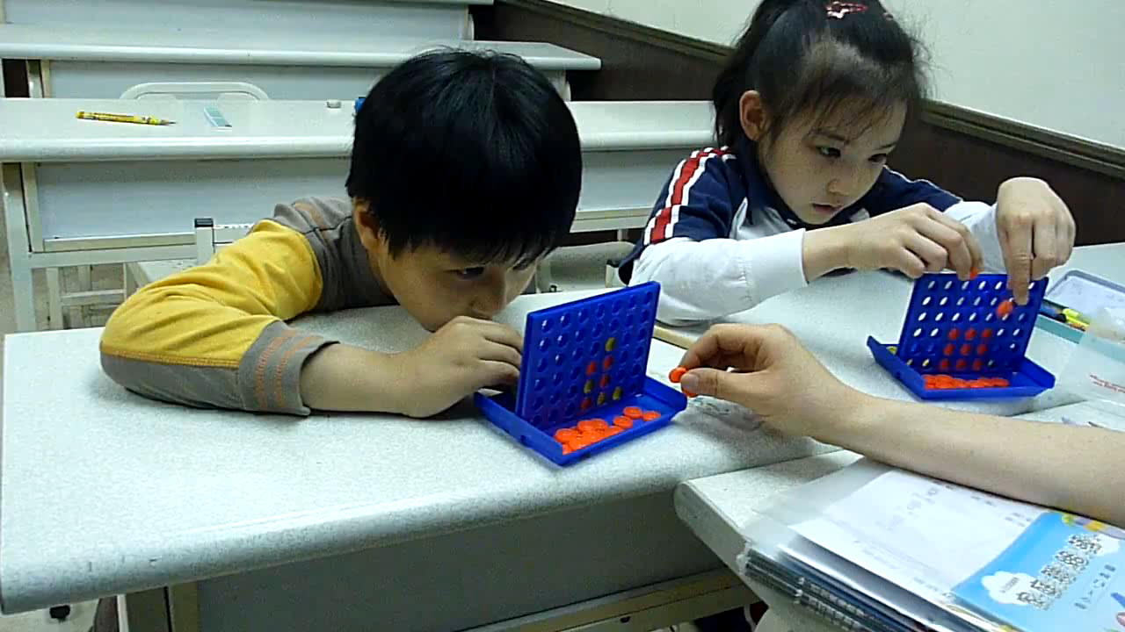
How to play 四子棋?

Slide 4
The rule of 四子棋
共 6 * 7 (row * col) 格
由上方投下
回合制 (turn by turn)
直、橫、或斜誰先連成 4 子誰就贏了

Slide 5
The features of our FPGA 四子棋
Two modes (controlled by the switch T1)
1-player mode (玩家(P1) vs. 電腦(AI)) (T1 = 0, switch up)
2-player mode (玩家(P1) vs. 玩家(P2)) (T1 = 1, switch down)
共 7 * 8 (row * col) 格 (on LCD)
14-seg LED displays whose turn and the winning message.
Press the key C on the keypad to reset the game any time.
Click one of the buttons S1~S8 to play (toss) chess.
Play sound as you toss your chess and as you win.
LED D16 lights up when one wins.

Slide 6
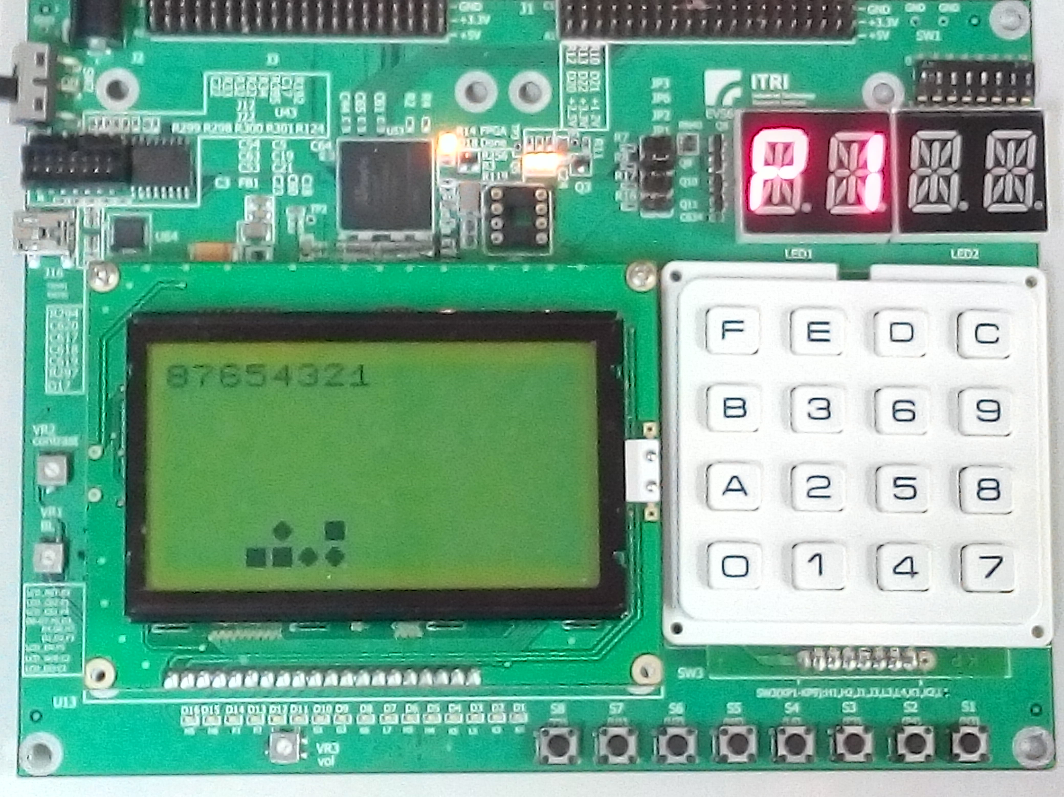
switch mode
status
reset
1st~8th col
correspond to
the button
S1~S8
two type of chess
lights up when one wins

Slide 7
Let’s Demo!!

